Slide 1
Chapter 5
How to get the data

Slide 2
Objectives
Applied
Use the Pandas read methods to import data into a DataFrame.
Download a file to disk before importing it into a DataFrame.
Unzip a zip file to access the files that it contains.
Use a SQL query to import database data into a DataFrame.
Use the metadata of a Stata file to analyze the data, and then read selected columns of the Stata data into a DataFrame.
Use JupyterLab to drill down into the data in a JSON file that has more than two levels of data, convert the JSON file to a dictionary, and then build a DataFrame from portions of the data in the dictionary.

Slide 3
Objectives (continued)
Knowledge
In general terms, describe the way that you get data in these formats into a DataFrame: CSV, Excel, database, Stata, and JSON.

Slide 4
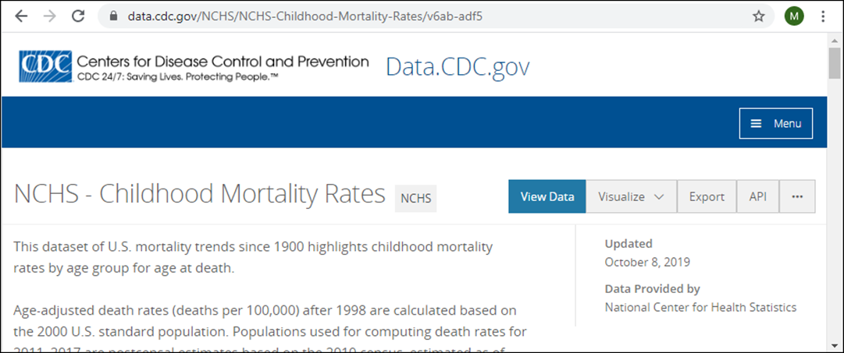
The download page for the Childhood Mortality data

Slide 5
Common sources of data
Internal datasets and databases
This can include everything from departmental spreadsheets to any of the databases used by a corporation.
Third-party websites
This includes the hundreds of websites that let you download data for your own analysis.
Good places to look for external datasets
Google Dataset Search: https://toolbox.google.com/datasearch
Kaggle: https://www.kaggle.com/datasets
Registry of Open Data on AWS: https://registry.opendata.aws

Slide 6
The websites for the case studies in this book
Child Mortality: Centers for Disease Control (data.cdc.gov)
2016 Polling: FiveThirtyEight (fivethirtyeight.com)
Forest Fires: U.S. Forest Service (fs.fed.us)
Social Survey: General Social Survey (gss.norc.org)
Sports Analytics: NBA stats (stats.nba.com)

Slide 7
Some file formats for data found on websites
Type | Extension | Description | Contents
CSV | .csv | Comma-separated values | One table
TSV | .tsv | Tab-separated values | One table
Excel | .xlsx, .xls | Excel spreadsheet | One or more sheets
Stata | .dta | Stata statistical package | Complex data
JSON | .json | JavaScript Object Notation | Nested data
XML | .xml | Extensible Markup Language | Nested data
SAS | .sd7, .sd6 | SAS statistical package | Complex data
SPSS | .sav | SPSS statistical package | Complex data
HDF5 | .h5 | Structured format for large datasets | Complex data
Zip | .zip | Archive format | One or more files

Slide 8
Some of the Pandas methods for importing data into a DataFrame
Method | Data format
read_csv(file) | CSV
read_excel(file) | Excel
read_stata(file,columns) | Stata
read_json(file) | JSON
read_hdf(file,columns) | HDF5
read_sas(file) | SAS
read_sql_query(query,con) | Database

Slide 9
How to import a CSV file from a website
mortality_url = \
"https://data.cdc.gov/.../rows.csv?accessType=DOWNLOAD"
mortality_data = pd.read_csv(mortality_url)

Slide 10
How to import the first sheet of a downloaded Excel file
jobs = pd.read_excel("oesm18all/all_data_M_2018.xlsx")

Slide 11
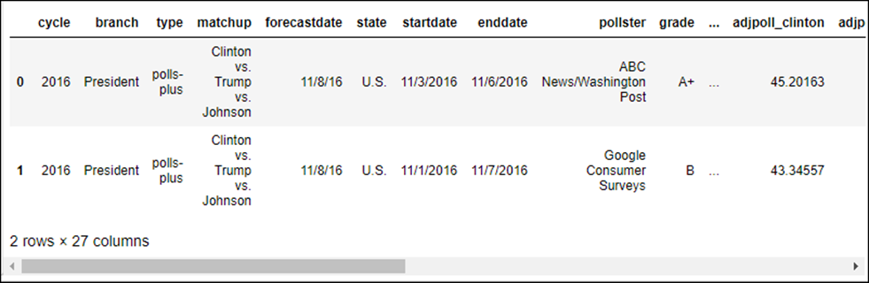
The urlretrieve() method of the urllib.request module
urlretrieve(url,filename)
How to download a file to disk
from urllib import request
polls_url = \ 'http://projects.fivethirtyeight.com/.../president_general_polls_2016.csv'
request.urlretrieve(polls_url, filename='president_polls_2016.csv')
How to import the file into a DataFrame
polls = pd.read_csv('president_polls_2016.csv')
polls.head(2)

Slide 12
Two methods of the ZipFile class
Method | Description
extractall() | Extracts all of the files from the zip file and saves them in the default directory.
infolist() | Reads the zip file and returns the file information as a list.

Slide 13
How to download a zip file to disk
from urllib import request
zip_url = 'https://www.bls.gov/oes/special.requests/oesm18all.zip'
request.urlretrieve(zip_url, filename='oesm18all.zip')
How to extract the files and list their names
from zipfile import ZipFile
file_names = list()
with ZipFile('oesm18all.zip', mode='r') as zip:
zip.extractall()
for file in zip.infolist():
file_names.append(file.filename)
print(file.filename, file.compress_size, file.file_size)
================================================================
oesm18all/all_data_M_2018.xlsx 70296790 71834374

Slide 14
Two ways to read an extracted file into a DataFrame
By specifying the filename
jobs = pd.read_excel("oesm18all/all_data_M_2018.xlsx")
By specifying the position of the file in the file_names list
jobs = pd.read_excel(file_names[0])

Slide 15
Packages for connecting to databases in Python
Package name | Database | Availability
sqlite3 | SQLite | Built-in
pymysql | MySQL | Needs to be installed
psycopg2 | PostgreSQL | Needs to be installed
cx_oracle | Oracle | Needs to be installed
pymssql | SQL Server | Needs to be installed

Slide 16
The connect() method of the SQLite module
connect(path)
The cursor() method of a connection object
cursor()
Two methods of a cursor object
execute(sql)
fetchall()

Slide 17
How to run queries on a SQLite database
Create a connection object and a cursor object
import sqlite3
fires_con = sqlite3.connect('Data/FPA_FOD_20170508.sqlite')
fires_cur = fires_con.cursor()
Run a query that lists the tables in the database
fires_cur.execute(
'SELECT name FROM sqlite_master WHERE type="table"').fetchall()
===================================================================
[('spatial_ref_sys',),
('spatialite_history',),
...
('Fires',),
...
('NWCG_UnitIDActive_20170109',)]

Slide 18
How to get information about a table
fires_cur.execute('PRAGMA table_info(Fires)').fetchall()
========================================================
[(0, 'OBJECTID', 'integer', 1, None, 1),
(1, 'FOD_ID', 'int32', 0, None, 0),
(2, 'FPA_ID', 'text(100)', 0, None, 0),
...
(12, 'FIRE_CODE', 'text(10)', 0, None, 0),
(13, 'FIRE_NAME', 'text(255)', 0, None, 0),
...
(19, 'FIRE_YEAR', 'int16', 0, None, 0),
(20, 'DISCOVERY_DATE', 'realdate', 0, None, 0),
...
(28, 'FIRE_SIZE', 'float64', 0, None, 0),
(29, 'FIRE_SIZE_CLASS', 'text(1)', 0, None, 0),
(30, 'LATITUDE', 'float64', 0, None, 0),
(31, 'LONGITUDE', 'float64', 0, None, 0),
...
(34, 'STATE', 'text(255)', 0, None, 0),
...
(38, 'Shape', 'POINT', 1, None, 0)]

Slide 19
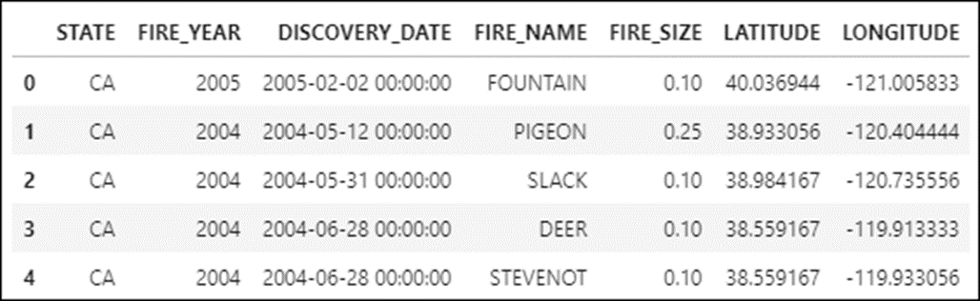
The read_sql_query() method
read_sql_query(SQL,connection)
How to import the data from a query into a DataFrame
fires = pd.read_sql_query(
'''SELECT STATE, FIRE_YEAR,
DATETIME(DISCOVERY_DATE) AS DISCOVERY_DATE,
FIRE_NAME, FIRE_SIZE, LATITUDE, LONGITUDE
FROM Fires''', fires_con)

Slide 20
The read_dta() method of the pyreadstat package
read_dta(filename,columns,metadataonly)
Some of the attributes for a metadata container
column_names
column_labels
number_columns
number_rows
How to install the pyreadstat module with a conda command
conda install --channel conda-forge pyreadstat --yes

Slide 21
How to get the metadata from a Stata file on disk
import pyreadstat
gss_stata_filename = 'GSS7218_R3.DTA'
gss_empty, gss_meta = pyreadstat.read_dta(
gss_stata_filename,
metadataonly=True)
type(gss_meta)
===============================================
<pyreadstat._readstat_parser.metadata_container

Slide 22
What the attributes of the metadata container can tell you
print("Number of columns:", gss_meta.number_columns)
print("Number of rows:", gss_meta.number_rows)
print("Column names:", gss_meta.column_names)
==============================================================
Number of columns: 6110
Number of rows: 64814
Column names: ['year', 'id', 'wrkstat', 'hrs1', 'hrs2', 'evwork', 'occ', 'prestige', 'wrkslf', 'wrkgovt', 'commute', 'industry', 'occ80', 'prestg80', 'indus80', 'indus07', 'occonet', 'found', 'occ10', 'occindv', 'occstatus', 'occtag', 'prestg10', 'prestg105plus', 'indus10', 'indstatus', 'indtag',
...

Slide 23
The DataFrame() constructor for a Stata file
Method | Description
DataFrame(params) | Constructs a DataFrame.
Parameters of the DataFrame constructor
Parameter | Description
data | Can be an array, dictionary, or other object that’s shaped like a table.
columns | Column labels. If they aren’t specified, they will be generated.
index | Row labels. If they aren’t specified, they will be generated.

Slide 24
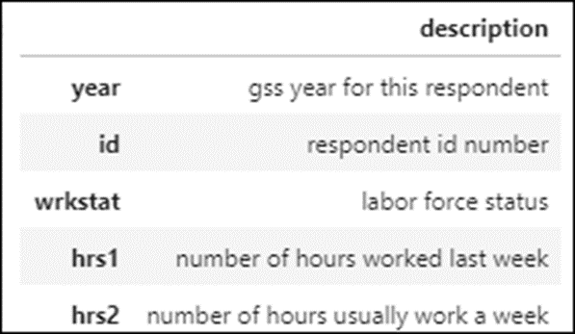
How to build a DataFrame for the column descriptions in the metadata
import pandas as pd
meta_cols=pd.DataFrame(
data=gss_meta.column_labels,
index=gss_meta.column_names,
columns=['description'])
meta_cols.head(5)

Slide 25
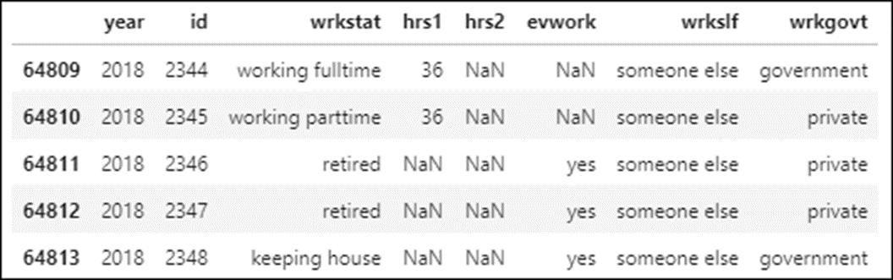
How to import seven columns of the data into a DataFrame
gss_data = pd.read_stata('GSS7218_R3.DTA',
columns=['year','id','wrkstat','hrs1','hrs2','evwork','wrkslf','wrkgovt'])
gss_data.tail()

Slide 26
How to download a JSON file to disk
import json
from urllib import request
shots_url = \
'https://www.murach.com/python_analysis/shots.json'
request.urlretrieve(shots_url, filename='shots.json')

Slide 27
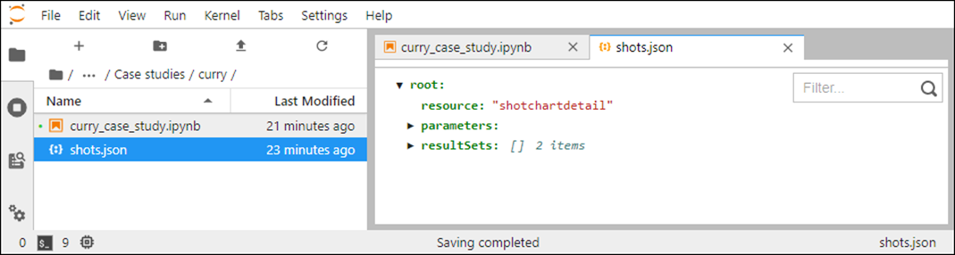
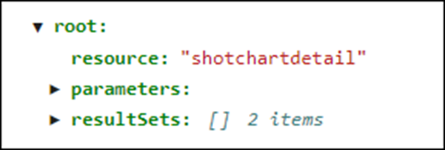
Double-click on the JSON file in JupyterLab to open it
The root level of the JSON file

Slide 28
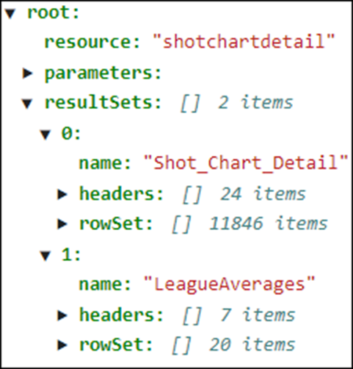
The first two levels of the resultSets data

Slide 29
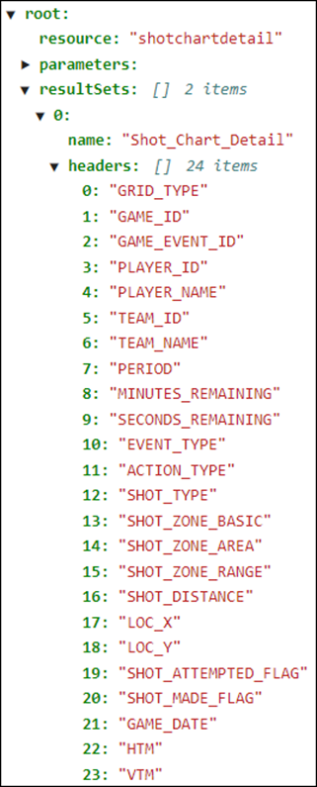
The headers level of the resultSets[0] data

Slide 30
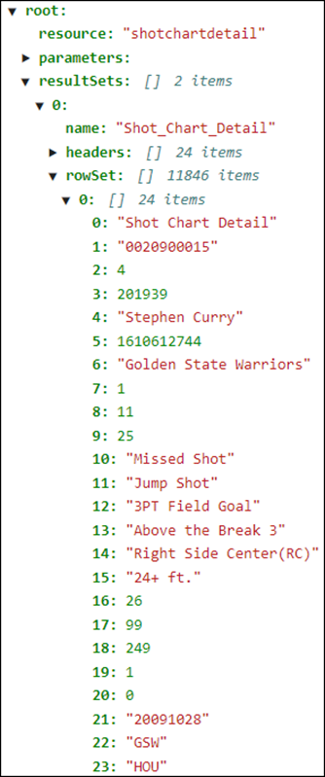
The rowSet level of the resultSets[0] data

Slide 31
The load() method of a JSON object
Method | Description
load() | Converts the data in a JSON file to a dictionary.
How to convert a JSON file to a dictionary
with open('shots.json') as json_data:
shots = json.load(json_data)

Slide 32
The DataFrame() constructor for a JSON file
Method | Description
DataFrame(params) | Constructs a DataFrame.
Parameters of the DataFrame constructor
Parameter | Description
data | Can be an array, dictionary, or other object that’s shaped like a table.
columns | Column labels. If they aren’t specified, they will be generated.
index | Row labels. If they aren’t specified, they will be generated.

Slide 33
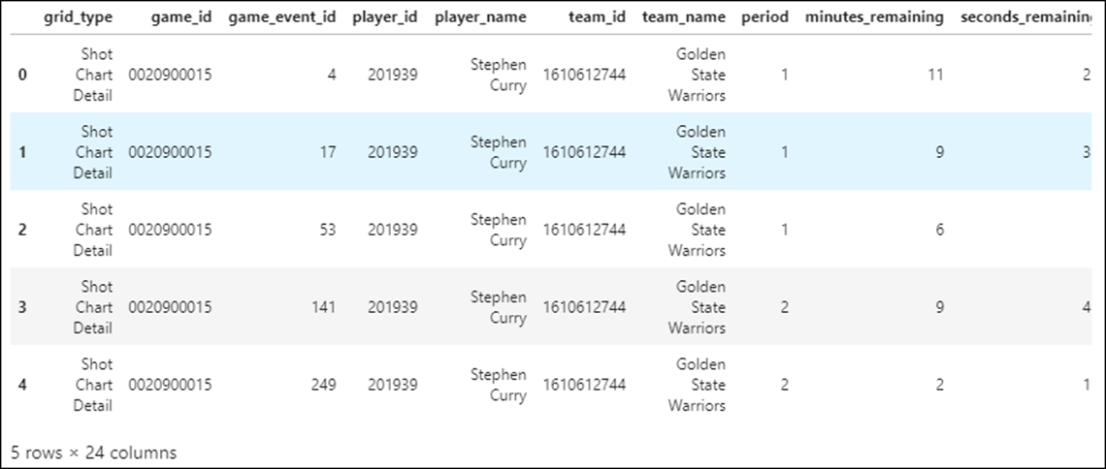
How to to build a DataFrame for the shots
allRows = shots['resultSets'][0]['rowSet']
columnHeaders = \
[x.lower() for x in shots['resultSets'][0]['headers']]
shots = pd.DataFrame(data=allRows, columns=columnHeaders)
shots.head()

